Slide 2
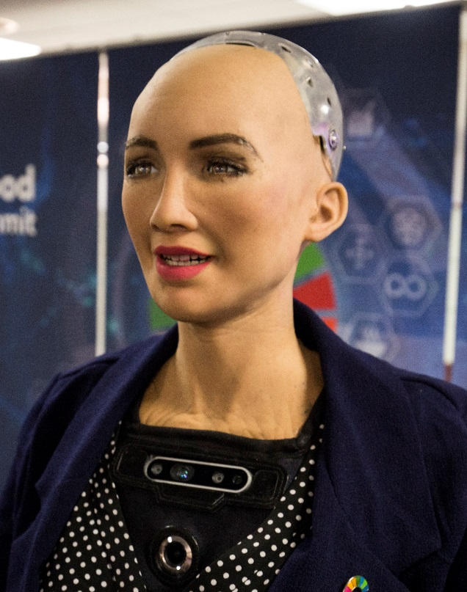
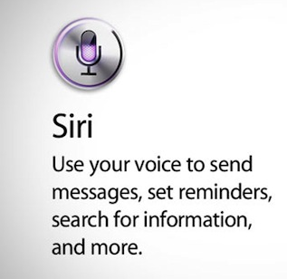


Sophia
SIRI
(or any other assistant)
https://www.google.com/search?q=mechanical+singularity&client=firefox-b-d&sxsrf=ACYBGNQnT29xYFAxNcA5sDnSoFFuTTq4XQ:1579789493599&source=lnms&tbm=isch&sa=X&ved=2ahUKEwjyyNe89pnnAhXM0aQKHQnvCYEQ_AUoAXoECAwQAw&biw=1366&bih=623#imgrc=0l14UNcWBe959M:
https://www.businessinsider.de/tech/interview-sophia-ai-roboter-hanson-2017-11/
https://www.hansonrobotics.com/sophia/
https://www.golem.de/specials/siri/
Developed by “Hanson Robotics“
At the time Hanson Robotics´ latest human like robot
In Greek Sophia means wisdom and Sophia is there for wisdom
Sophia and her creators dream of a future were human and robots live near together
Best known for a scene out of an Interview with “Business“, where Sophia said she wants to destroy humanity
How A.I. influences our lifes
Siri stands for Speech Interpretation and Recognition Interface
With Siri you are able to search only by speaking
Another Assistant is
OK Google
You can talk with them like with humans
Contents:
A.I. definition
Some examples and explanations
Singularity
A.I. short definition
A.I. stands for artificial intelligence
Contrast to natural intelligence, which describes the Human intelligence
A.I can learn to do complicated work or solving complexe questions
A.I. often is used for easy singlepayer games
Some people are afraid of the Singularity
Singularity
Many Singularitys in all kinds of research
Mechanical and technological Singularity
people are afraid of mechanical Singularity
Mechanical Singularity: Point where humans can no longer control the machines
Technical Singularity: hypothetic point where every technical achivement gets achived in one second

